Slide 1
FORMS
U3.L6-
Splitting pages with <div> tags & Navigation

Slide 2

DO NOW
Welcome! Please do the following:
Open your laptops
Create a Repl.it Project named Splitting Pages With Div’s
Open Your unit 3 Planning Document in a separate Tab

Slide 3

Agenda
Do Now
How Div’s Work
Live Demo
Work Time

Slide 4

Objectives
Understand how to create a consistent navigation bar throughout multiple pages using the <div> tag.
Create a navigation path between multiple pages/sections.

Slide 5
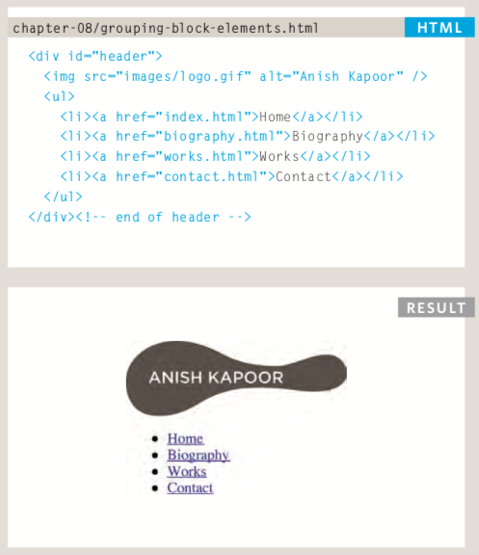
How Div’s Work

Slide 6
[LIVE DEMO]
Creating a Form

